Slide 1
Component Architecture

Slide 2
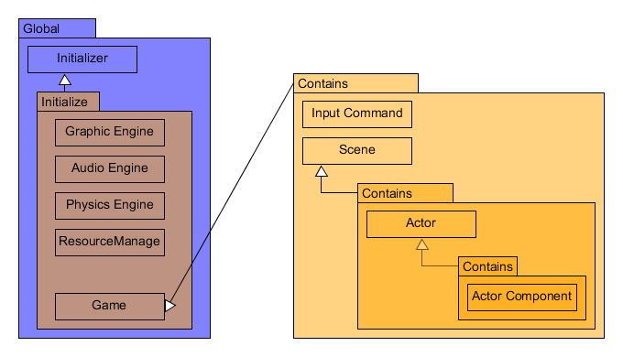
Game Engine Class Diagram

Slide 3
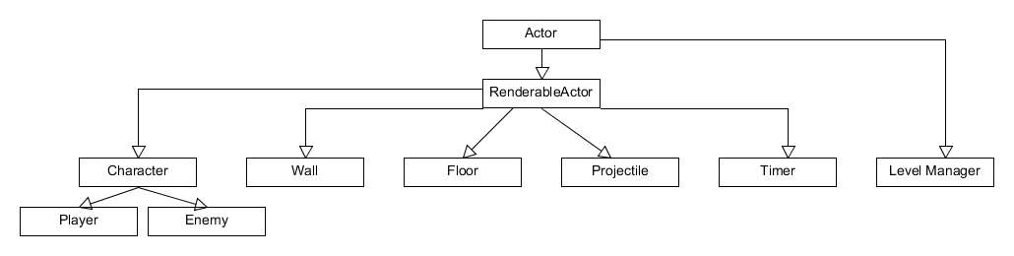
Actor Class Inheritance

Slide 4
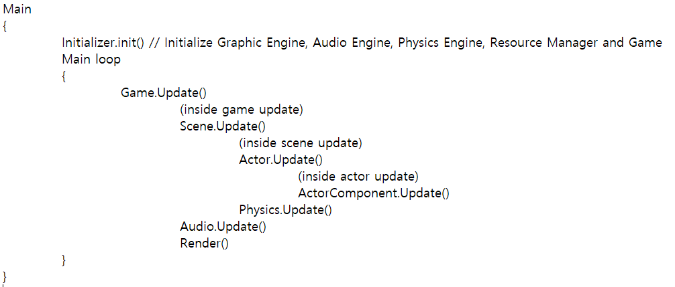
Main Loop

